Slide 1
Snow Removal
Contractor: Example Contractor
Client: Example Client
Agreement #111-11-11 dated 01.11.2024
Structure type F6
Construction count: 2 pcs.
Installation address: Sample District, Example Street 137A, pedestrian area
Reporting period: 01.12.2024-31.12.2024

Slide 2
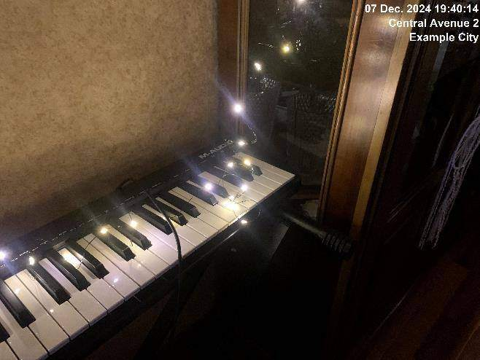
07.12.2024
Construction 1
Snow removal required

Slide 3
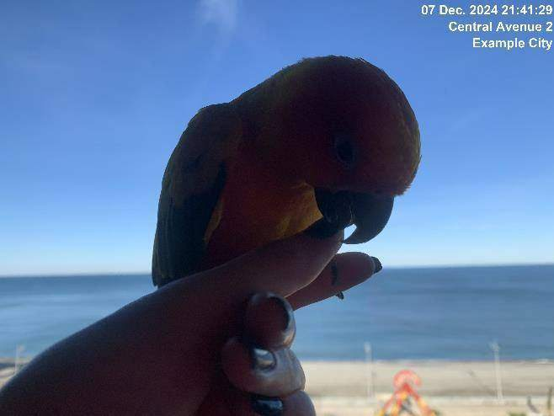
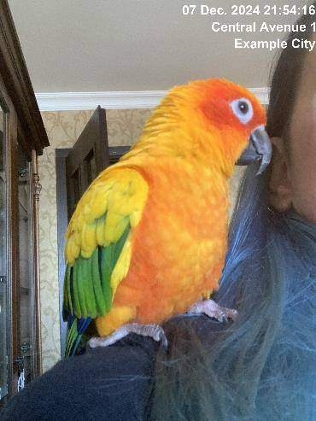
07.12.2024
Construction 1
Snow cleared

Slide 4
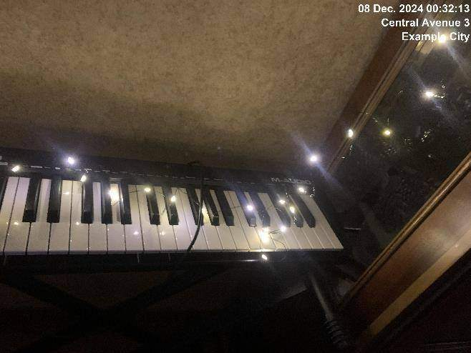
07.12.2024
Construction 1
Issue resolved

Slide 5
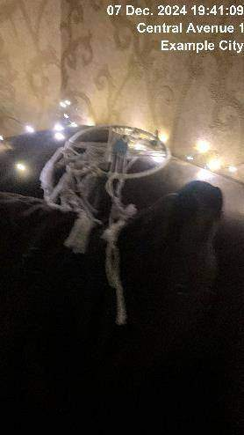
07.12.2024
Construction 2
Snow removal required

Slide 6
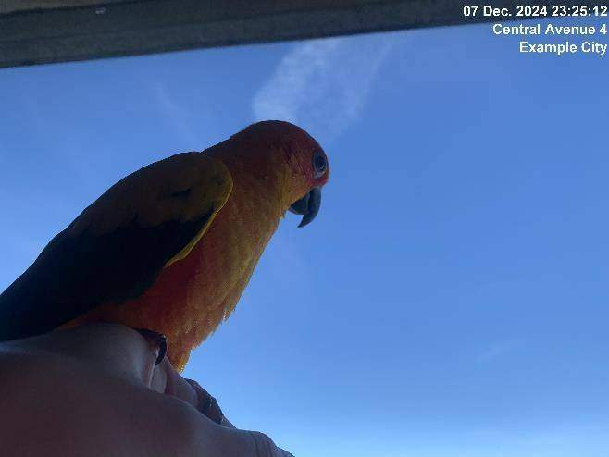
07.12.2024
Construction 2
Snow cleared

Slide 7

07.12.2024
Construction 2
Snow cleared

Slide 8
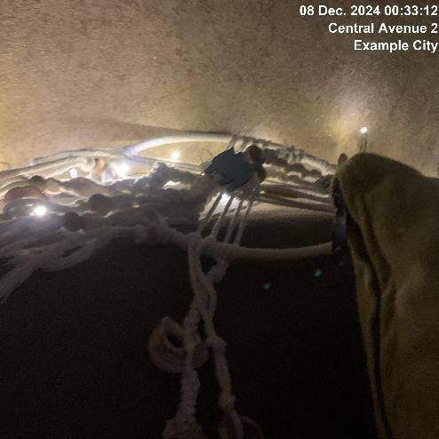
07.12.2024
Construction 2
Issue resolved

Slide 9
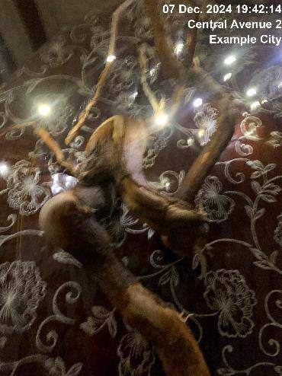
07.12.2024
Construction 3
Snow removal required

Slide 10
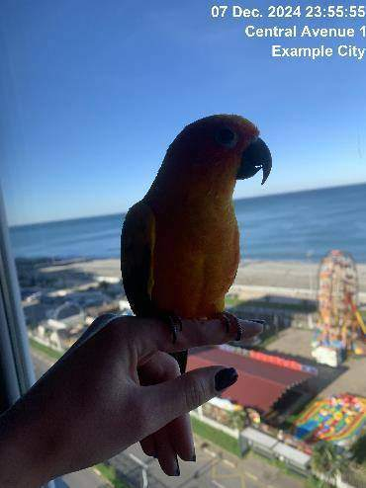
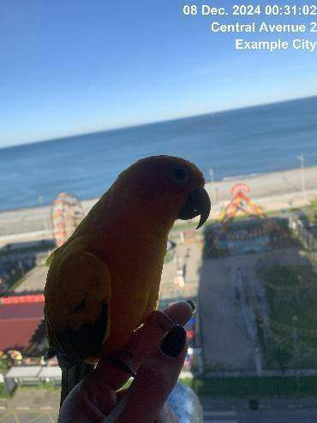
07.12.2024
Construction 3
Snow cleared

Slide 11
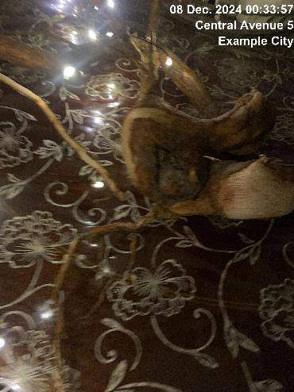
07.12.2024
Construction 3
Issue resolved

Slide 12
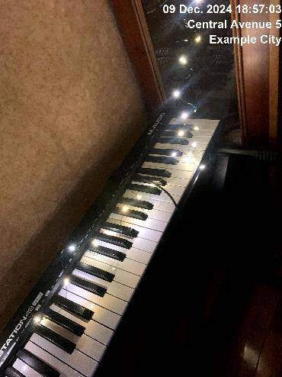
09.12.2024
Construction 1
Snow removal required

Slide 13

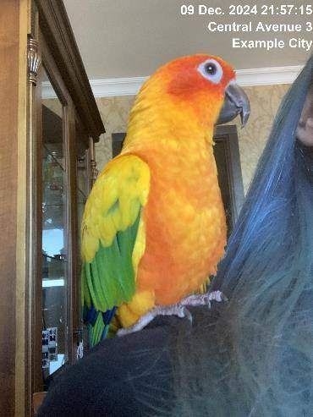
09.12.2024
Construction 1
Snow cleared

Slide 14
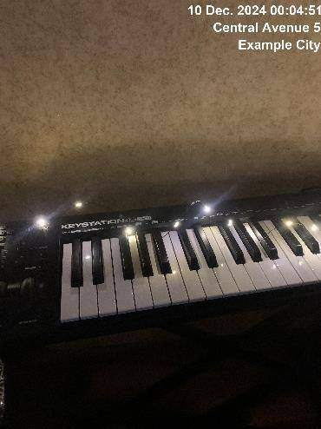
09.12.2024
Construction 1
Issue resolved

Slide 15
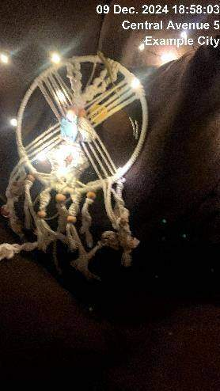
09.12.2024
Construction 2
Snow removal required

Slide 16
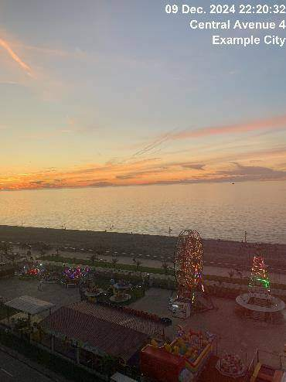
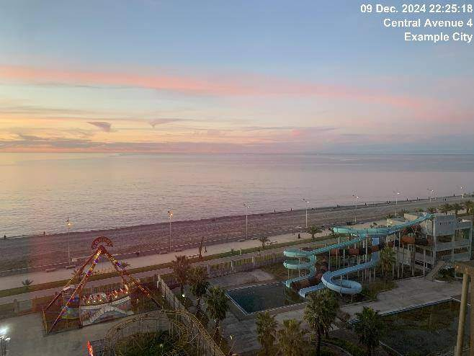
09.12.2024
Construction 2
Snow cleared

Slide 17
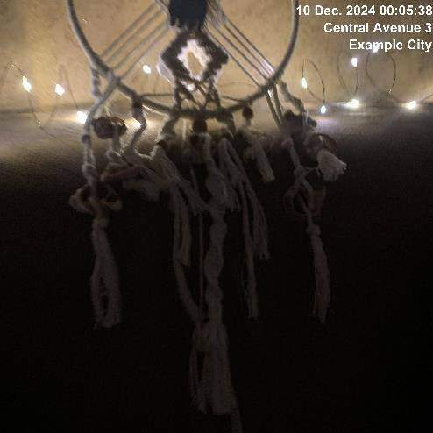
09.12.2024
Construction 2
Issue resolved

Slide 18
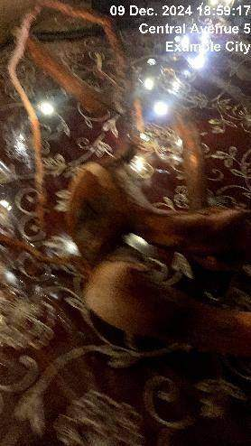
09.12.2024
Construction 3
Snow removal required

Slide 19

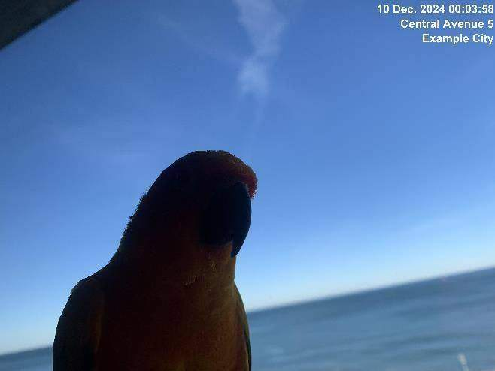
09.12.2024
Construction 3
Snow cleared

Slide 20
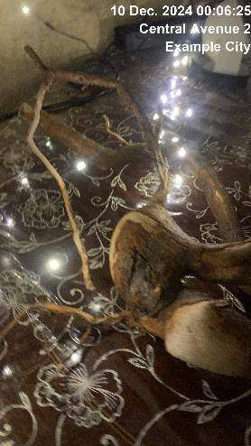
09.12.2024
Construction 3
Issue resolved

Slide 21
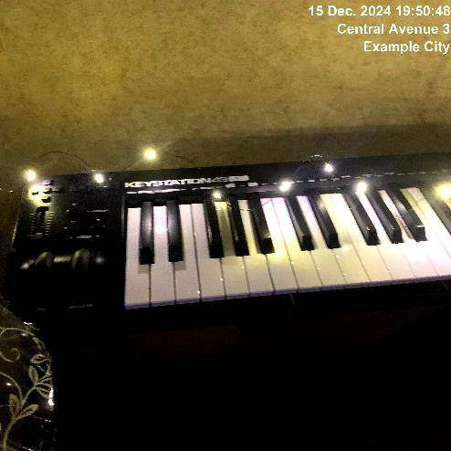
15.12.2024
Construction 1
Snow removal required

Slide 22
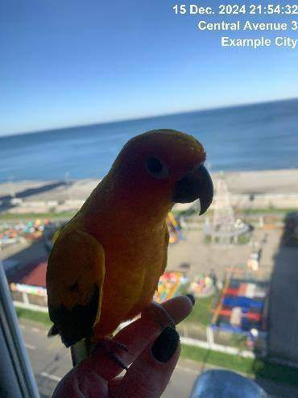
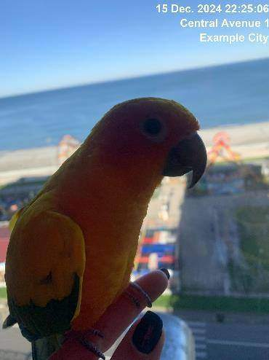
15.12.2024
Construction 1
Snow cleared

Slide 23
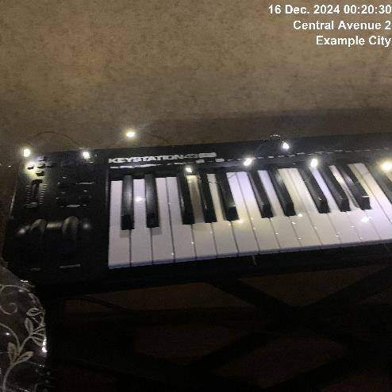
15.12.2024
Construction 1
Issue resolved

Slide 24
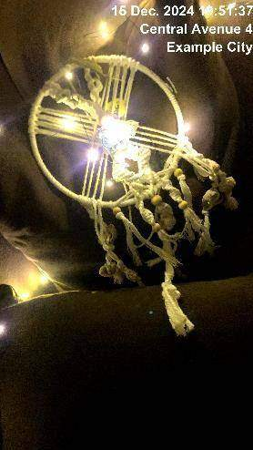
15.12.2024
Construction 2
Snow removal required

Slide 25
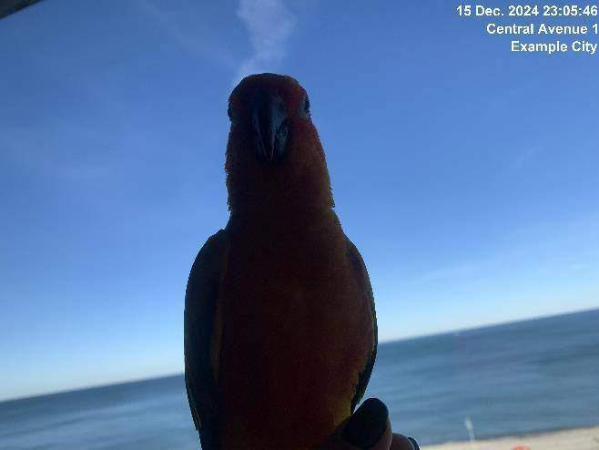
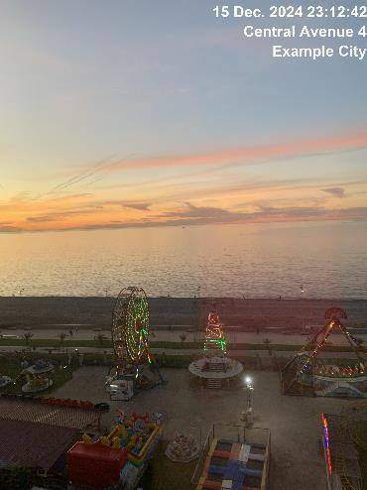
15.12.2024
Construction 2
Snow cleared

Slide 26
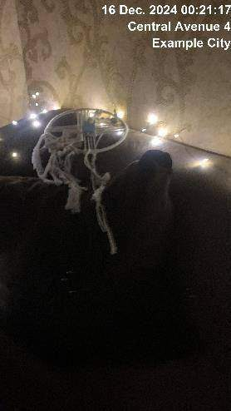
15.12.2024
Construction 2
Issue resolved

Slide 27
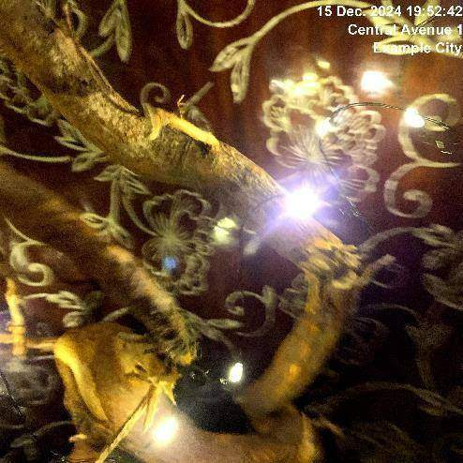
15.12.2024
Construction 3
Snow removal required

Slide 28
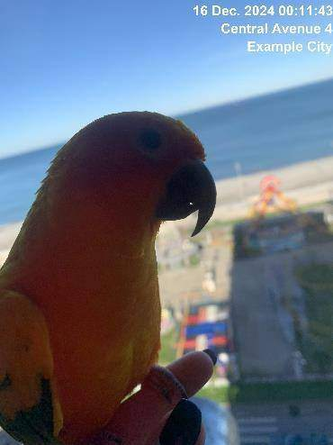
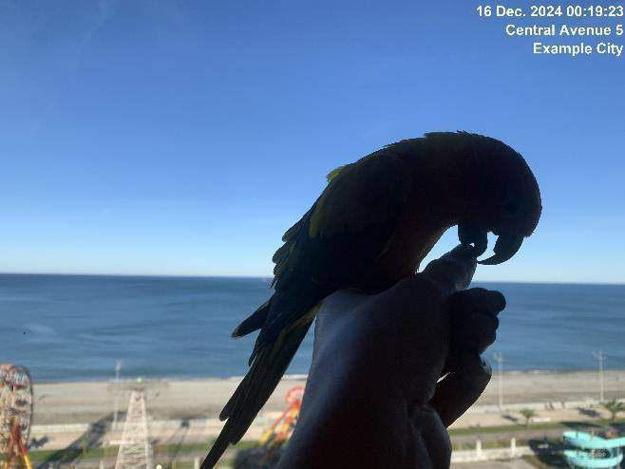
15.12.2024
Construction 3
Snow cleared

Slide 29
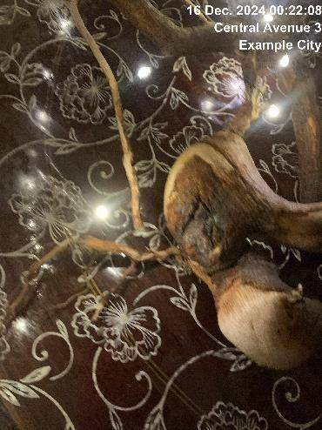
15.12.2024
Construction 3
Issue resolved

Slide 30
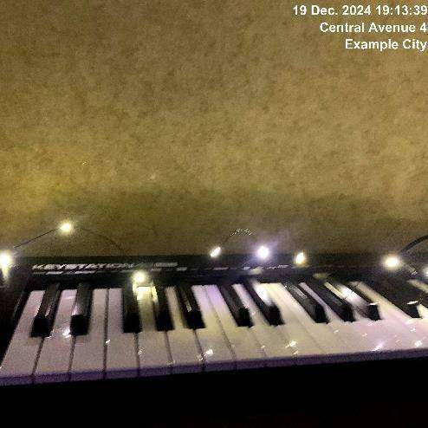
19.12.2024
Construction 1
Snow removal required

Slide 31
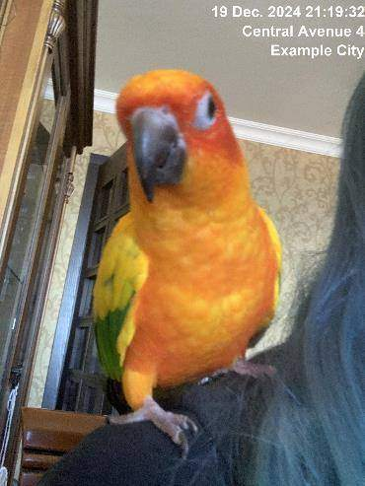
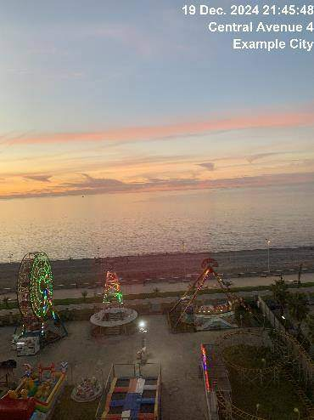
19.12.2024
Construction 1
Snow cleared

Slide 32
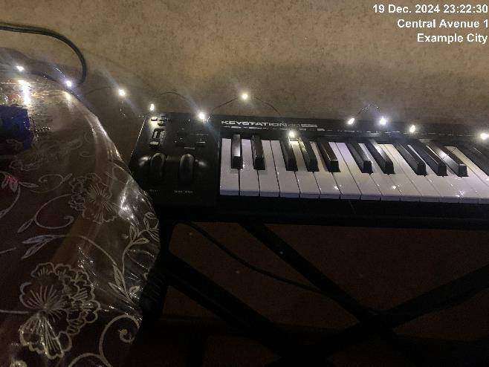
19.12.2024
Construction 1
Issue resolved

Slide 33
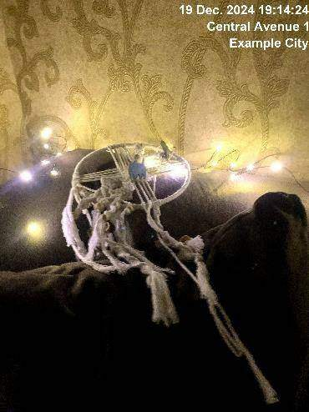
19.12.2024
Construction 2
Snow removal required

Slide 34
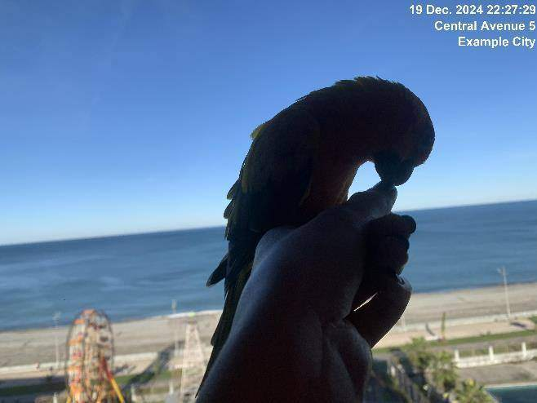
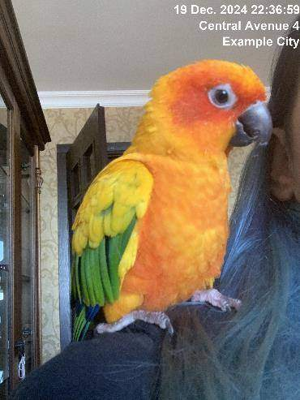
19.12.2024
Construction 2
Snow cleared

Slide 35
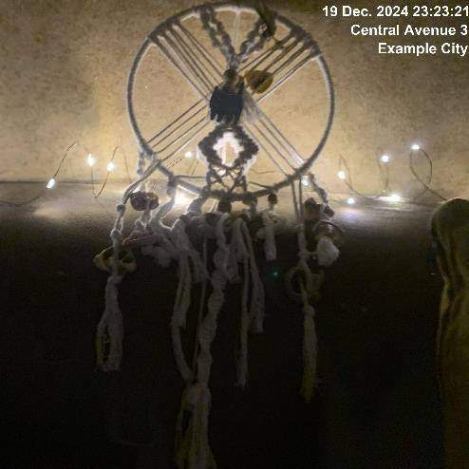
19.12.2024
Construction 2
Issue resolved

Slide 36
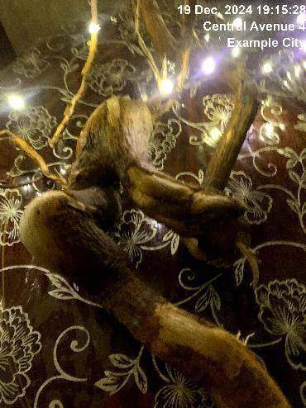
19.12.2024
Construction 3
Snow removal required

Slide 37
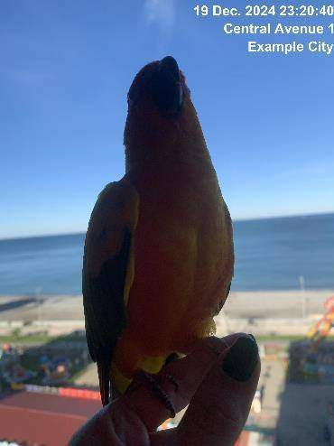
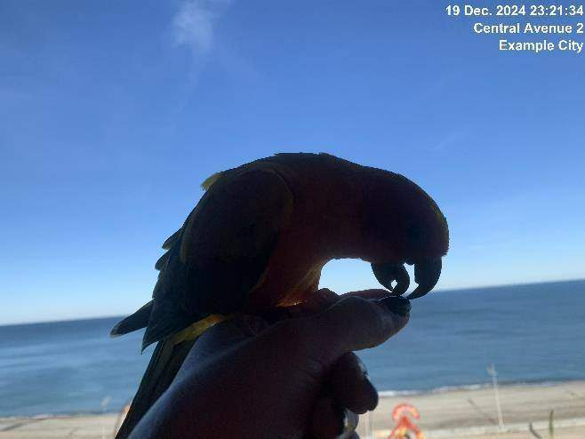
19.12.2024
Construction 3
Snow cleared

Slide 38
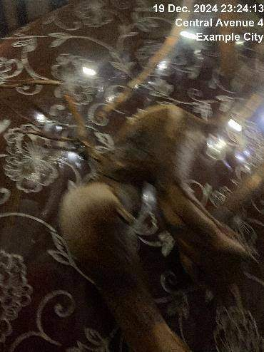
19.12.2024
Construction 3
Issue resolved

Slide 39
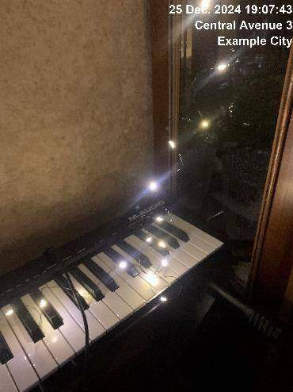
25.12.2024
Construction 1
Snow removal required

Slide 40
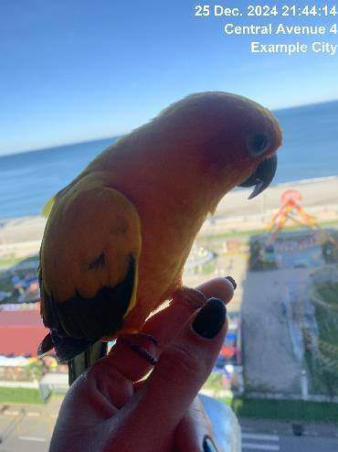
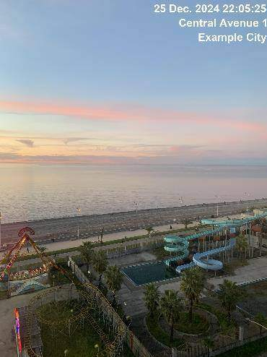
25.12.2024
Construction 1
Snow cleared

Slide 41
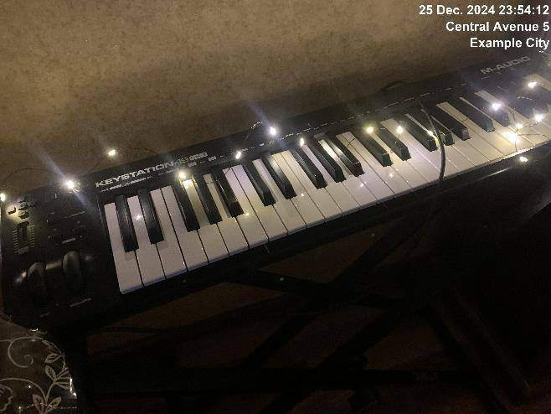
25.12.2024
Construction 1
Issue resolved

Slide 42
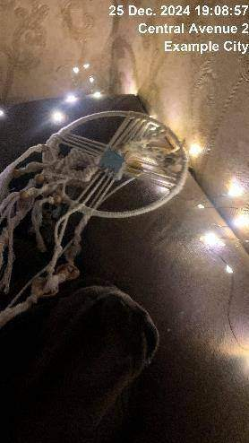
25.12.2024
Construction 2
Snow removal required

Slide 43


25.12.2024
Construction 2
Snow cleared

Slide 44

25.12.2024
Construction 2
Issue resolved

Slide 45

25.12.2024
Construction 3
Snow removal required

Slide 46


25.12.2024
Construction 3
Snow cleared

Slide 47

25.12.2024
Construction 3
Issue resolved

